Slide 1
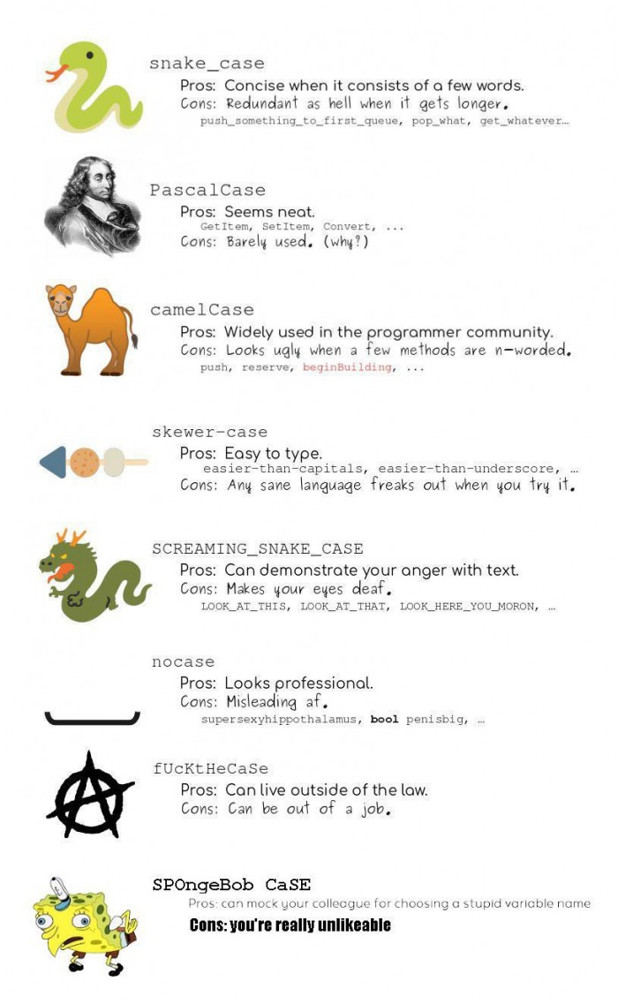
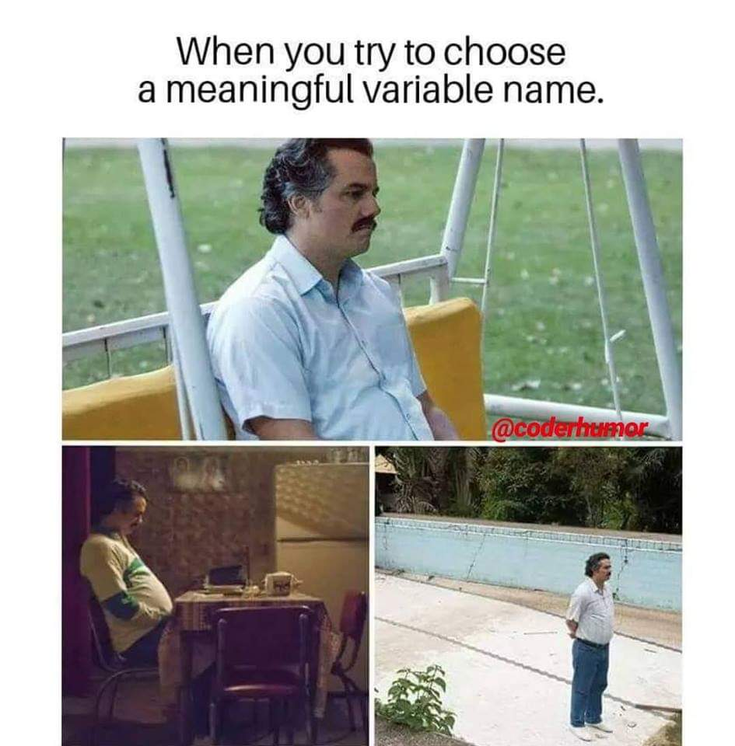

Scripts, style, and variable classes
How to write code that you can still read later, and what type of data you can find in MATLAB

Slide 2
Topics
Introduction: GUI and basic calculations
Coding 1: Scripts, style, and variable classes
Coding 2: Control statements and loops
Visualization 1: Basics, subplots, get and set
Coding 3: Functions
Visualization 2: Descriptive plots
Coding 4: Basic input and output
Visualization 3: Distribution and 3D plots
Coding 5: Input and output specials – last lecture before holidays
Machine Learning 1: Introduction and dimension reduction
Machine Learning 2: Clustering
Machine Learning 3: Classification
Coding 6: Efficiency and debugging basics
Coding 7: Advanced functions and debugging

Slide 3
Scripts
Text files with code and *.m file extension
Best viewed in the MATLAB Editor, but you can choose!
Comments with % (CTRL-R, CTRL-T)
Code Sections with %%
Can be folded
Play button (F5) to run entire script
Right click -> Evaluate selection (F9) to run highlighted text
CTRL-Enter to run code sections

Slide 4
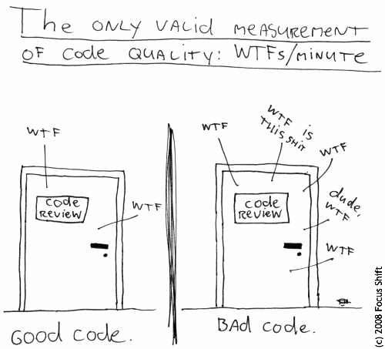
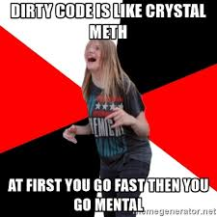
Style

Slide 5
Style
Makes the code readable, reusable, and adaptable
Makes it easier to avoid, find, and fix bugs
Programming style is personal, but guidelines are very helpful
Understanding the importance of clean code is an essential part of the course. You will get badly styled code to clean.
Comments
Own line, discuss code reasoning and goal
The better the code, the fewer comments are necessary.
Indents for functions and control loops

Slide 6
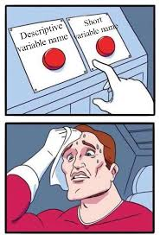
Variable Naming
Rules
Cannot start with numbers
Cannot contain special characters except “_”
Recommendations
Avoid single letter variables, except for very simple testing
Avoid overly long variables that just annoy everyone
Use short, but meaningful names
No abbreviations like ("compwid" vs "compute_total_width“)
It’s a disease you can find all over MATLAB scripts for some reason but it’s horrible
Avoid names that already exist (check "which <variable>" first, if unsure)
Prefixes: n, i, is, has, can, do, check, compute, find, etc.

Slide 7
Variable Naming
Separate words with
camelCase (common in other languages, _ is being used as subscript in MATLAB)
usage_of_underscores (better readability)
Both are legit options, but stick to one!

Slide 8
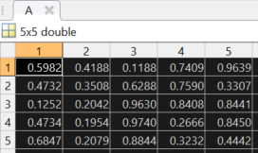
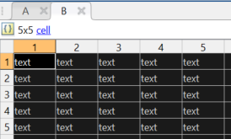
Variable Classes I
Numerics
Scalars, Vectors, Matrices
Indexing with (i), deletion with = []
Integers, doubles, singles
Character arrays
Strings also exist, but char is most frequent
Logicals
True/false, using == ~= < > <= >= or other functions, combined with && and ||
Structs
Flexible and complex, combination of fields and values, indexing by „.“
Cells
Can hold different classes, indexing with {i}
Test with „class()“, is*(), or isa(x,‘<class>‘)

